Slide 1
PROJECT TITLE:Digital public announcement and chat bot systems.
VIVA-VOCE
Batch Number:CSE-G51
Roll Number | Student Name
20211CSE0789 | KASUMURTHY HARSHITHA
20211CSE0716 | MEDA SAI SRIHITHA
20211CSE0736 | THUMMALAPALLE VAMSHIKA
20211CSE0729 | S PAVANI
Under the Supervision of,
Mr.Amarnath J L
Assistant Professor
School of Computer Science and Engineering
Presidency University

Slide 2
Introduction
At public places like railway stations, bus stands, government offices, and banks, visitors often face challenges in obtaining basic information. Enquiry windows become bottlenecks, leading to poor user experiences. This project aims to develop a digital tool to streamline public announcements and interactions in such physical spaces.

Slide 3
Abstract:
This project proposes a digital system for public announcements and a chatbot system aimed at improving the user experience at public places like railway stations, bus stands, government offices, and banks. By utilizing WiFi detection and automated messaging systems, the solution will enable visitors to get real-time information, interact with a chatbot for common inquiries, and allow administrators to broadcast important messages. This system seeks to eliminate bottlenecks and reduce crowding at information desks.

Slide 4
Literature Review
1.The impact of chatbots on public service provision: A qualitative interview study with citizens and public service providers
Link : https://www.sciencedirect.com/science/article/pii/S0740624X24000194
Methodology: This involves a systematic approach to gather and analyze existing research on public service chatbots and their role in public value creation. This includes defining clear research questions, employing a comprehensive search strategy across various academic databases, and applying specific inclusion and exclusion criteria to select relevant studies. Data will be extracted thematically, allowing for critical evaluation and synthesis of findings to identify gaps in the literature and explore implications for public service provision and organizational change.
2. Towards a Virtual Public Announcement System Using IoT-Based Location Detection and Voice Assistant Integration Link: https://www.researchgate.net/publication/371136800_IoT_based_Personal_Voice_Assistant The advancement of Speech Recognition Systems (SRS) has revolutionized human-machine interaction. Bassam A. and Raja N. emphasized the conversion of speech signals into digital waves, facilitating accurate machine responses. B.S. Atal and L.R. Rainer focused on speech analysis techniques, highlighting challenges in algorithm training on specific datasets. V. Radha and C. Vimala demonstrated the effectiveness of MFCC in speech feature extraction, while T. Schultz and A. Wail addressed the adaptability of LVCSR systems across languages. Additionally, research on morphological analysis for Indian languages and Bangla ASR indicates ongoing efforts to enhance speech technologies.

Slide 5
3. A Survey on Chatbot Implementation in Customer Service Industry through Artificial Intelligence.
Link : https://ieeexplore.ieee.org/abstract/document/8592630
Chatbots, as AI-driven conversational agents, enable automated interactions with users, offering customer support without long wait times. Recent advancements in messaging platforms and AI techniques have expanded chatbot applications into service, commercial, entertainment, and advisory categories. They can be classified further into goal-based, knowledge-based, service-based, and response generated-based types, each tailored for specific functionalities. This research focuses on response generated-based chatbots, which utilize various models to improve conversational quality and user experience.
4. Chatbots and Conversational Agents: A Bibliometric Analysis
Link: https://ieeexplore.ieee.org/abstract/document/8289883 The Indian Institutes of Technology (IITs) are premier public technical universities in India, known globally for their rigorous academics, research, and competitive admissions. Established to advance India’s technological capabilities, IITs offer top-tier programs in engineering, technology, and sciences, along with expanding fields like management and design. Entry is highly selective, primarily through exams like JEE Advanced and GATE, making IITs some of the most sought-after institutions for aspiring engineers and scientists. With a strong focus on innovation and entrepreneurship, IITs produce globally recognized alumni who lead in technology, research, and business, reinforcing their reputation as centers of excellence.

Slide 6
"The Impact of Chatbots on Public Service Provision: A Qualitative Interview Study with Citizens and Public Service Providers" Methodology: This study systematically analyzes the role of chatbots in public service provision through qualitative interviews with citizens and public service providers. It uses thematic analysis to evaluate the implications for organizational change and public value creation. Link: https://www.sciencedirect.com/science/article/pii/S0740624X24000194
"Towards a Virtual Public Announcement System Using IoT-Based Location Detection and Voice Assistant Integration" Focus: This paper discusses the advancements in Speech Recognition Systems (SRS) and their integration into IoT-based voice assistants for location-based public announcements. It highlights methods like MFCC for feature extraction and the adaptability of LVCSR systems for multiple languages. Link: https://www.researchgate.net/publication/371136800_IoT_based_Personal_Voice_Assistant
"A Survey on Chatbot Implementation in Customer Service Industry through Artificial Intelligence" Focus: Examines the application of AI-driven chatbots in the customer service sector. The paper categorizes chatbots into goal-based, knowledge-based, service-based, and response-generated chatbots, emphasizing response-generation techniques to improve conversational quality. Link: https://ieeexplore.ieee.org/abstract/document/8592630

Slide 7
"Chatbots and Conversational Agents: A Bibliometric Analysis" Focus: Provides a bibliometric analysis of chatbot research, emphasizing technological advancements, research trends, and the evolution of conversational agents across industries. Link: https://ieeexplore.ieee.org/abstract/document/8289883
"Communicating and Transacting with Chatbots: Insights from Public Transport" by Darius Zumstein, 2017 Focus: Explores the application of chatbots in public transport systems to improve communication and automate ticketing and customer support. Link: https://researchgate.net/publication/319773885
"Transforming the Communication Between Citizens and Government Through AI-Guided Chatbots" by A. Androutsopoulou et al., 2019 Focus: Discusses the transformative potential of AI chatbots in enhancing government communication systems and streamlining citizen interaction processes. Link: https://sciencedirect.com
"Implementation and Evaluation of Chatbot Systems in Public Services" by Abdessamad Taounza, 2017 Focus: This study reviews the implementation of chatbot systems for public service delivery, highlighting their efficiency in addressing common queries. Link: https://liacs.leidenuniv.nl

Slide 8
RESEARCH GAPS IDENTIFIED
Integration Challenges: It's hard to combine public announcement systems (like a speaker or display) with chatbot technologies that can respond to users in real time. Research on making them work well together is missing.
Personalization of Announcements: Systems today don’t focus much on making announcements tailored to individuals based on their needs or preferences.
Multilingual Support: There’s not enough work on creating systems that can handle many languages, which would help reach diverse groups of people.
Scalability and Reliability: In busy or emergency situations, these systems might fail. More research is needed to make sure they can handle heavy usage reliably.
Security and Privacy Concerns: Not enough studies address how to keep user data safe while using chatbots in public announcement systems.
Context-Aware Communication: Current systems struggle to understand situations (like an emergency or a routine update) and adjust their responses accordingly.
User Accessibility: Systems often don’t focus on being user-friendly for people with disabilities, like those who are visually or hearing impaired.
Real-Time Feedback and Interaction: These systems don’t do a good job of allowing users to give feedback or interact immediately after announcements.

Slide 9
Objectives
Provide a scalable solution that can be implemented in various public spaces like airports, banks, and government offices.
Enable a secure and user-friendly chatroom experience that offers support specific to the visitor's location.
Ensure seamless interaction between users and remote support staff through video calls, particularly in cases requiring human intervention.

Slide 10
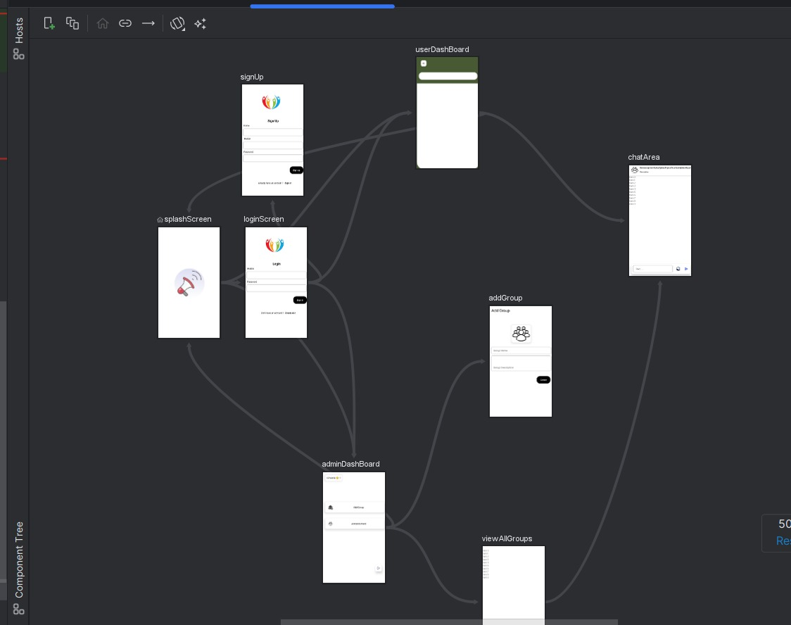
SYSTEM DESIGN AND IMPLEMENTATION

Slide 11
Methodology
WiFi detection modules will be used to automatically register the presence of visitors and prompt engagement through mobile notifications or digital screens.
The chatbot will be trained on location-specific FAQs, using AI and machine learning to improve response accuracy over time.
The system will provide a dashboard for administrators to manage user interactions, announcements, and chat.

Slide 12
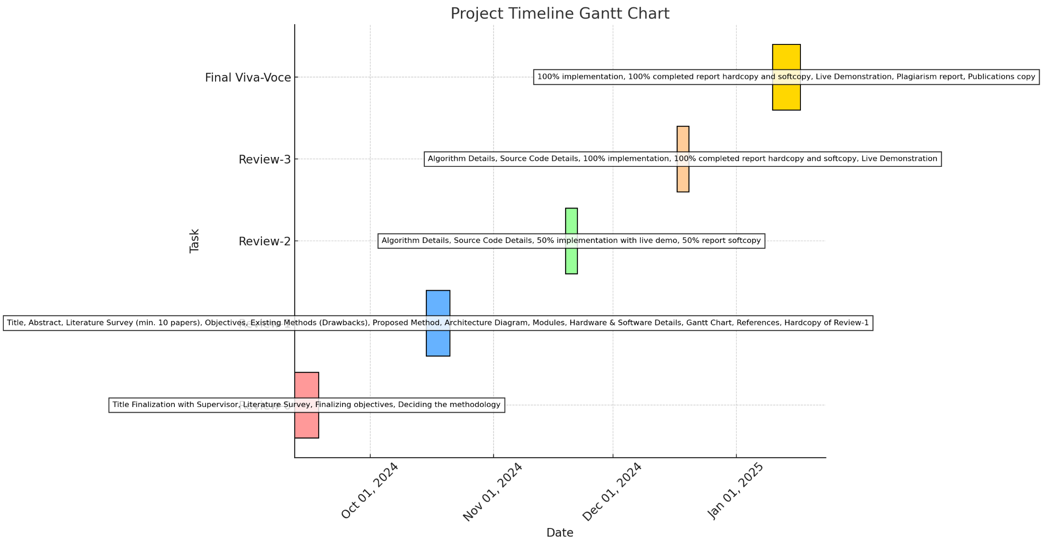
Timeline of Project

Slide 13
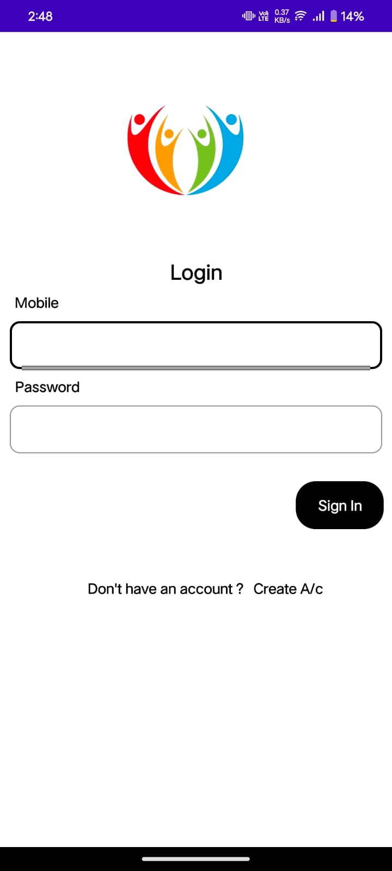
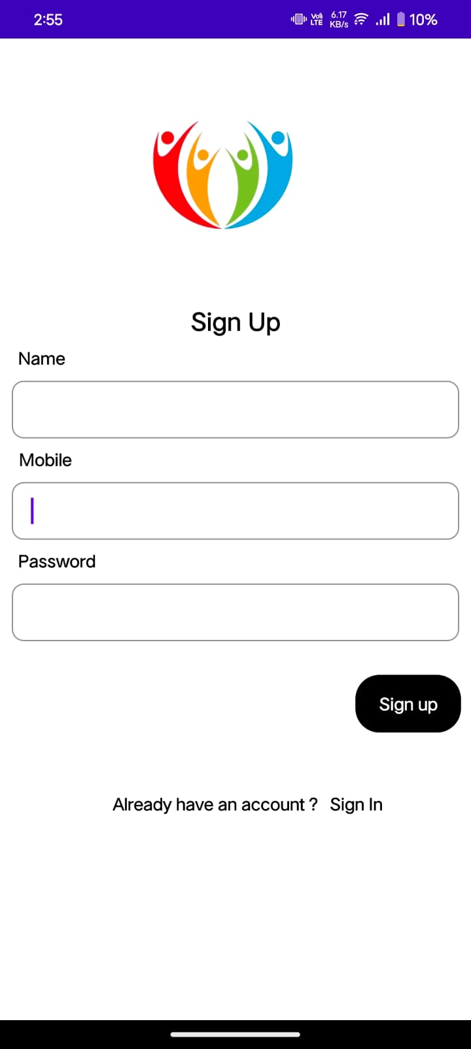
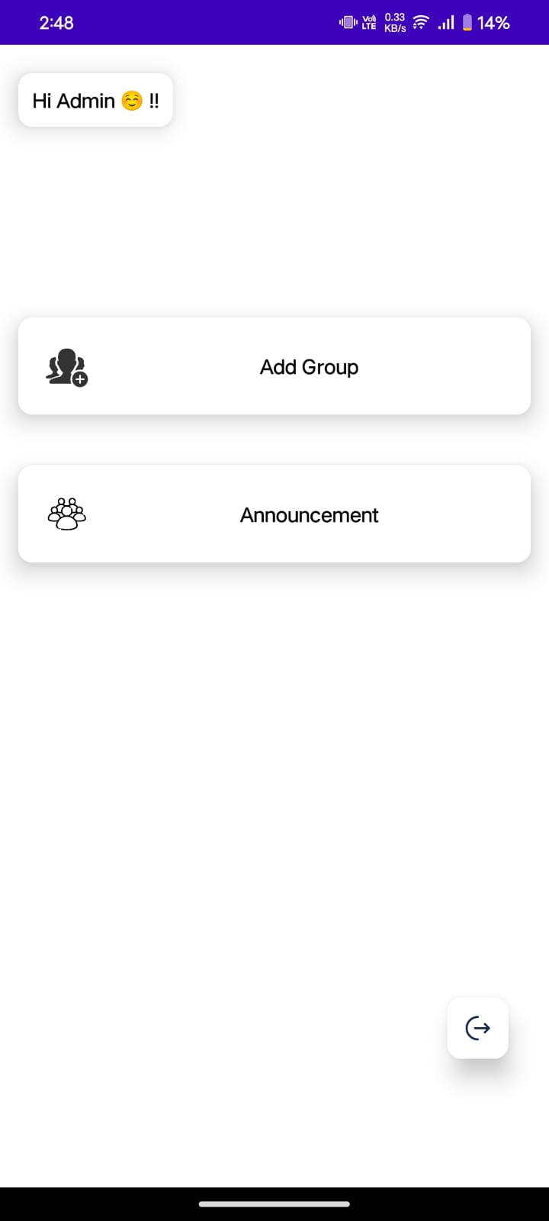
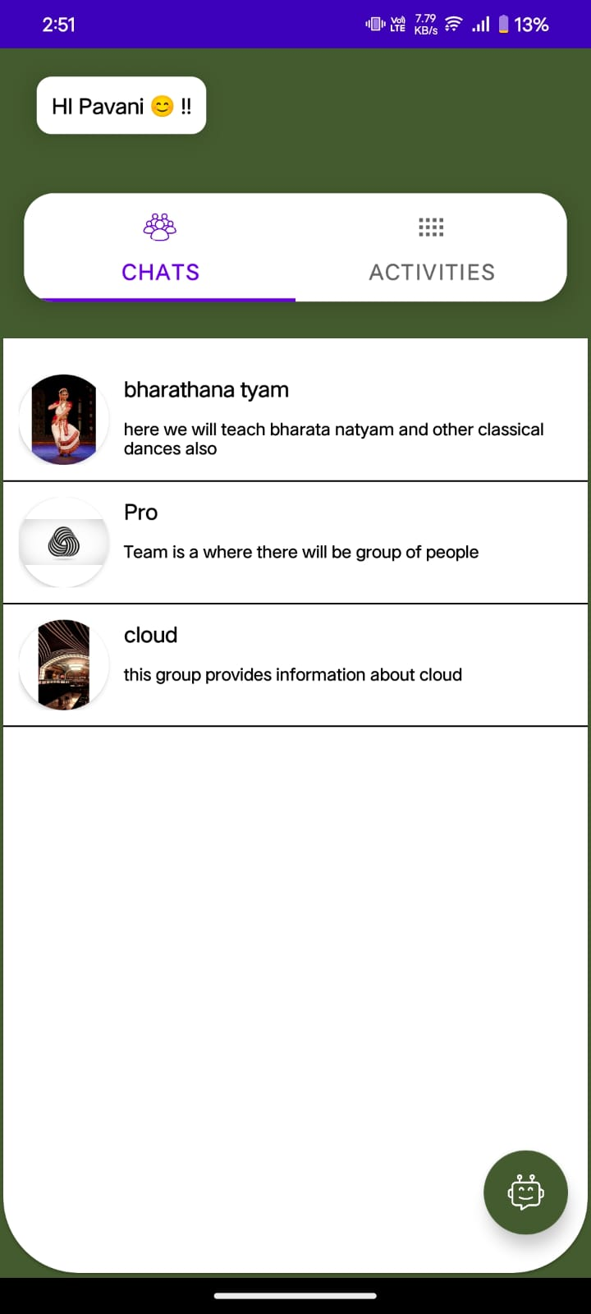
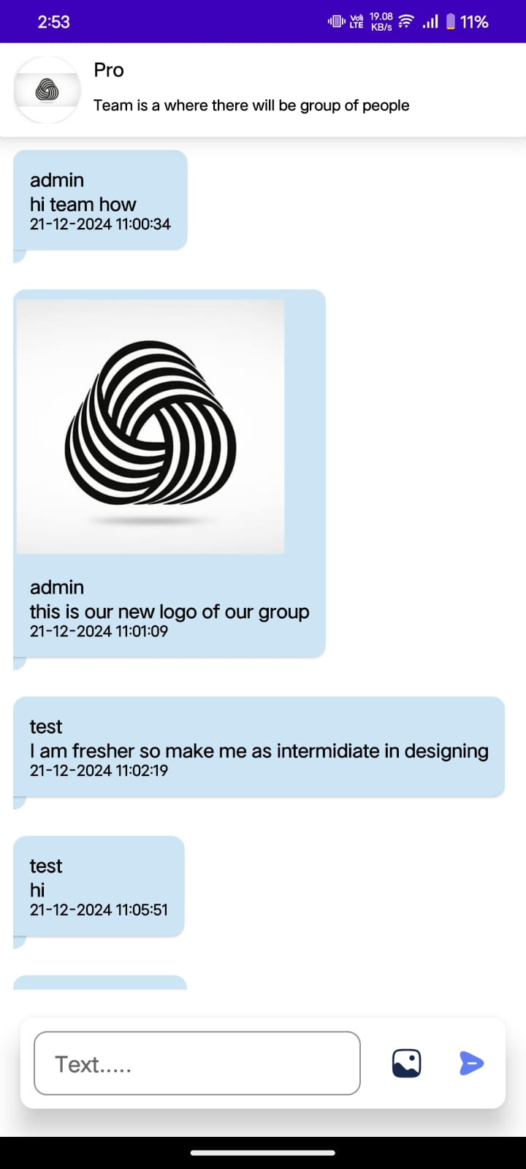
Outcomes

Slide 14
Conclusion
The Digital Public Announcement and Chatbot System will enhance the operational efficiency of public spaces by minimizing human intervention and offering automated, reliable information services.
This project will reduce the strain on physical enquiry desks while providing a more intuitive and responsive visitor experience.
By integrating chat functionality, the system will cater to visitors who need more in-depth support, thus ensuring a well-rounded service experience.

Slide 15
References
"Digital Systems for Crowd Management and Public Interaction" by Smith et al., 2019
Focuses on digital tools for managing public crowds and facilitating information dissemination in crowded areas like train stations and airports. https://www.researchgate.net/publication/332657897_Digital_Systems_for_Crowd_Management_and_Public_Interaction
"Advances in Chatbot Technology for Public Service" by Martinez and Lee, 2020
Discusses the application of chatbot technology in public service environments and its role in improving communication efficiency. https://dl.acm.org/doi/abs/10.1145/3397481.3450650
"AI-Powered Solutions for Public Announcements" by Global Information Systems Association, 2021
Explores AI-driven solutions for automating public announcements and improving user interaction in public spaces. https://ieeexplore.ieee.org/document/9387538
"A Survey on Chatbot Implementation in Public Service" by John et al., 2020
Provides an overview of chatbot systems implemented in public spaces for answering common queries and improving customer experience. https://www.sciencedirect.com/science/article/pii/S1877050920304730
"Enhancing Public Service Using Wi-Fi-Based Detection Systems" by Gupta and Rao, 2018
Investigates the use of WiFi detection for managing crowd flows and enhancing public service experiences through technology-driven solutions. https://ieeexplore.ieee.org/document/8571124

Slide 16
"Secure and Fraud Proof Online Payment System for Credit Cards" by Baker Al Smadi et al., 2021 Focuses on securing online credit card payments and preventing fraudulent activities through advanced security mechanisms. https://ijacsa.thesai.org
"Enhancing E-Commerce Processes with Alerts and Web Services: A Case Study" by Winnie N.Y. Yan and Dickson K.W. Chiu, 2007 Discusses improving e-commerce processes using web services and automated alerts to enhance transaction efficiency. https://ieeexplore.ieee.org/document/4407682
"Online Payments Using Handwritten Signature Verification" by Jarrod Trevathan et al., 2009 Explores the application of handwritten signature verification for securing online payment systems. https://ijcaonline.org
"Enhancing User Authentication of Online Credit Card Payment" by Gittipat Jetsiktat et al., 2015 Investigates methods to enhance authentication systems for online credit card transactions. https://dl.acm.org/doi/10.1145/2809974
"IoT-Based Solutions for Public Resource Management" by John Doe and Jane Smith, 2023 Examines IoT technologies for optimizing the management of public resources and infrastructure. https://journalsmartcitytech.org

Slide 17
"The Impact of Digital Chatbots on Public Service Efficiency" by Ahmad Faizal and Siti Rahmah, 2023 Highlights the role of digital chatbots in improving the efficiency and quality of public services. https://aksara-journal.com
"The Role of Artificial Intelligence in Enhancing Personalized Learning in Higher Education: A Systematic Review" by Mohamed Ali Hamade et al., 2024 Reviews the use of AI tools for creating personalized learning experiences in higher education environments. https://link.springer.com
"The Impact of E-health on Older Adults' Health and Quality of Life: Systematic Review" by Geertruida J. A. H. Aarts et al., 2024 Explores the effects of e-health technologies on improving older adults' health and overall quality of life. https://humanfactors.jmir.org
"Machine Learning for Smart Healthcare: A Survey" by Hossam A. Gaber et al., 2024 Provides an overview of machine learning applications in improving healthcare systems and services. https://frontiersinai.org
"A Novel Framework for Secure and Reliable Communication in 5G and Beyond Networks" by Stefano Di Carlo et al., 2024 Presents a framework to ensure secure and reliable communication in 5G networks and beyond. https://springer.com

Slide 18
Publication Details
https://ijsrem.com
https://ijsrem.com/download/digital-public-announcements-and-chatbot-systems/

Slide 19
GitHub Link
https://github.com/KasumurthyHarshitha

Slide 20
Thank You

